Slide 1
TEAM -019
ARUNPANDIYAN S
SNS COLLEGE OF TECHNOLOGY

Slide 2
PROBLEM STATEMENT
PSE1 – Personalized Learning Platform
Problem: Design an adaptive learning platform that can cater to individual student needs and learning styles while providing meaningful analytics to educators.
Description: The platform should be able to assess student performance, identify learning gaps, and provide personalized content recommendations.
No personalized learning path
Limited AI-based doubt clarification
Low engagement and motivation
No adaptive study planning
Poor analytics for instructors and admins
One-size-fits-all course structure

Slide 3
EXISTING SOLUTION AND GAP
Existing Solutions
Coursera https://www.coursera.org/
Udemy https://www.udemy.com/
Traditional College LMS
YouTube Learning
User Survey Insights (Sample Study)
From student feedback and research observations:
68% students struggle to choose the right course path
72% prefer AI-based doubt solving
61% want structured weekly study plans
70% feel more motivated with rewards/badges
Conclusion: Students need an AI-driven intelligent .

Slide 4
PROPOSED SOLUTIONS
Role-based login (Learner / Instructor / Admin)
AI Assistant powered by Llama 3.3 70B or gemini 1.5
Gamification system (6 levels + 15 badges)
Real-time analytics dashboard
Quiz system with smart scoring
Secure authentication using Firebase

Slide 5
TECH STACK
Frontend
React + TypeScript
Vite
Tailwind CSS
React Router
Backend
Firebase Authentication
Firebase Realtime Database
Firebase Analytics
AI
Qubrid Platform API or Gemini api key
Llama 3.3 70B Instruct Model

Slide 6
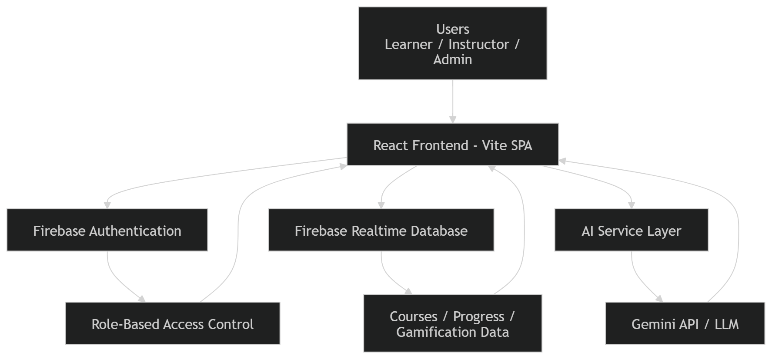
ARCHITECTURE

Slide 7
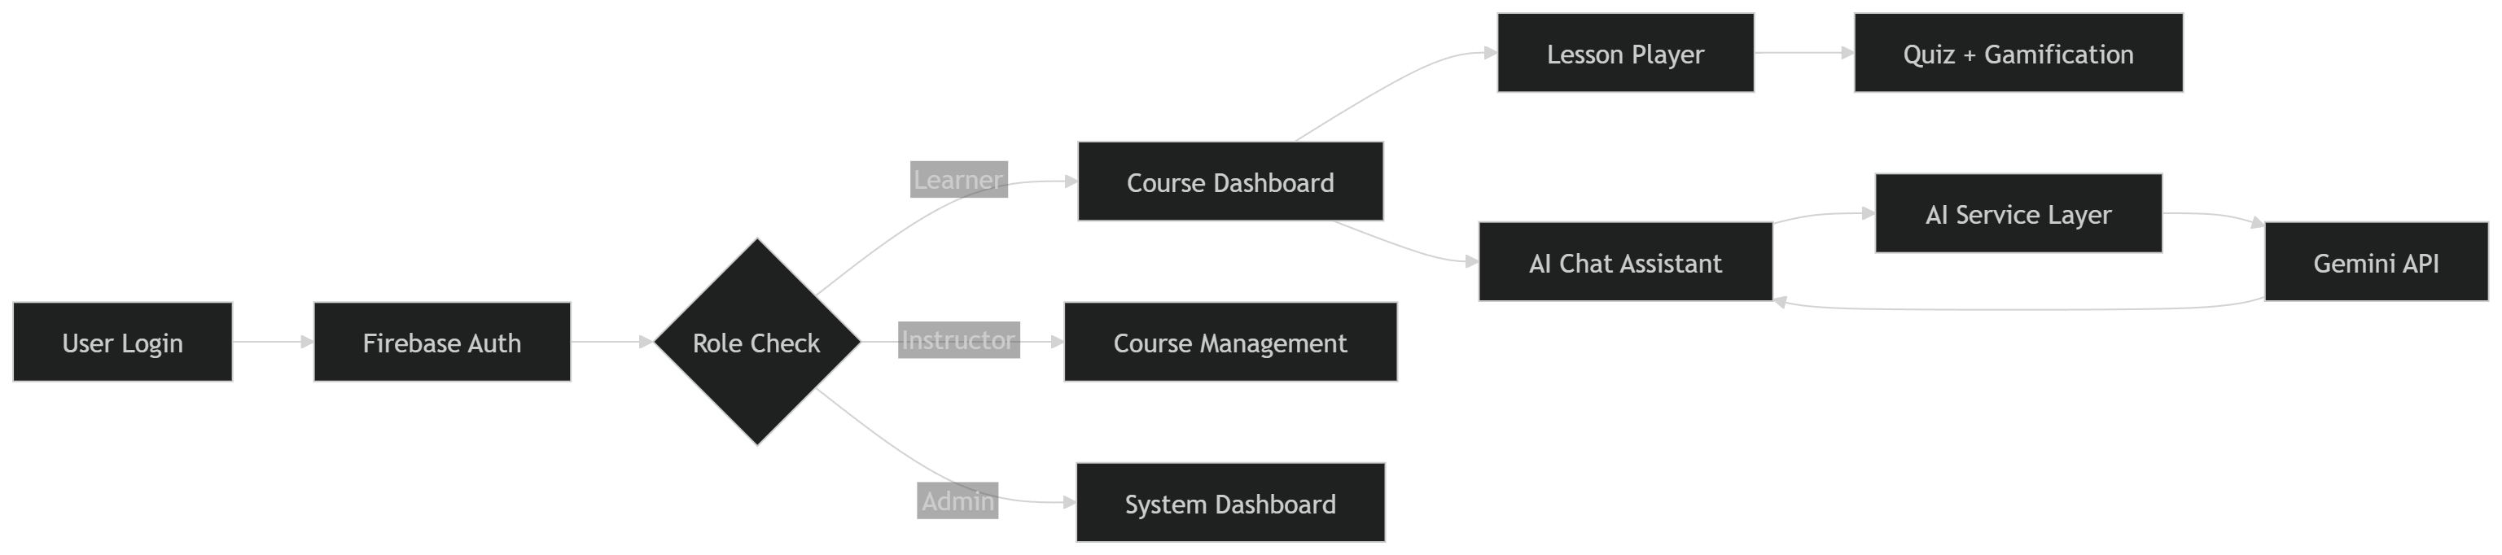
FLOW DIAGRAM

Slide 8
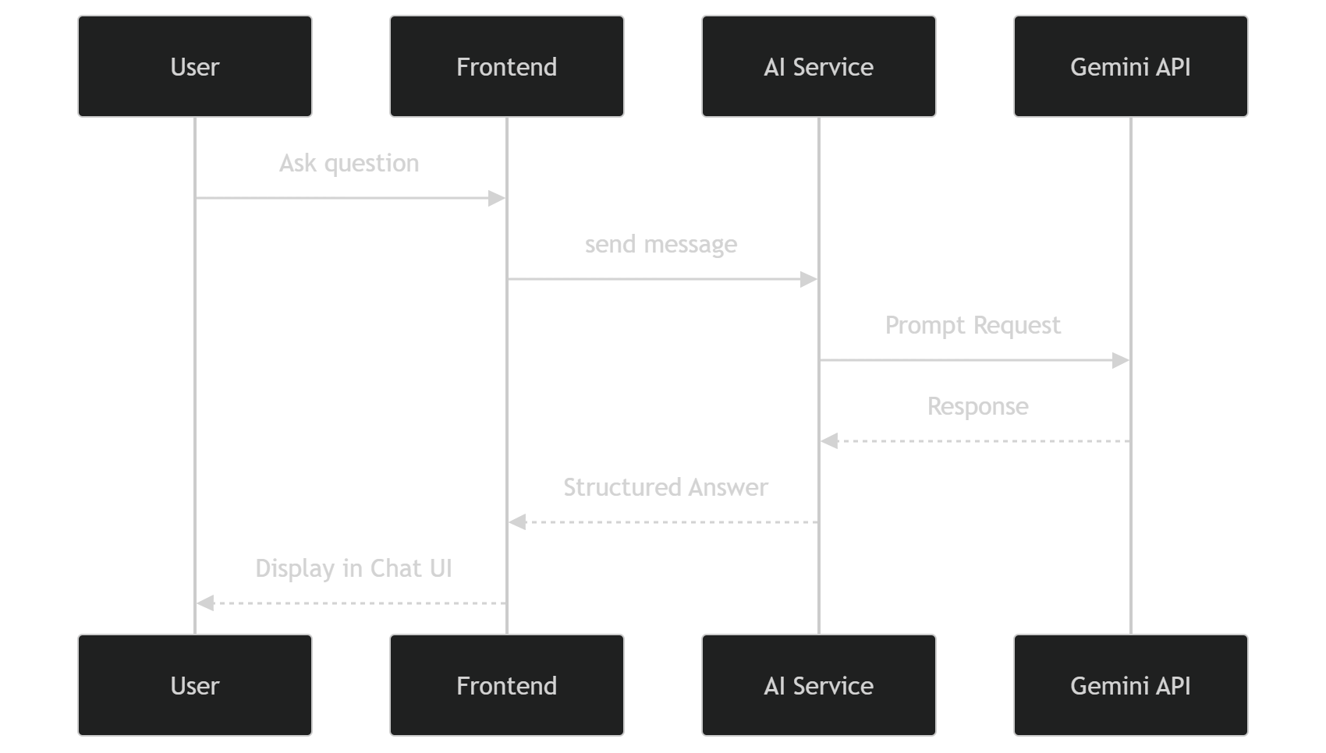
AI Architecture

